Slide 1
Notations
Kenny Lim

Slide 2
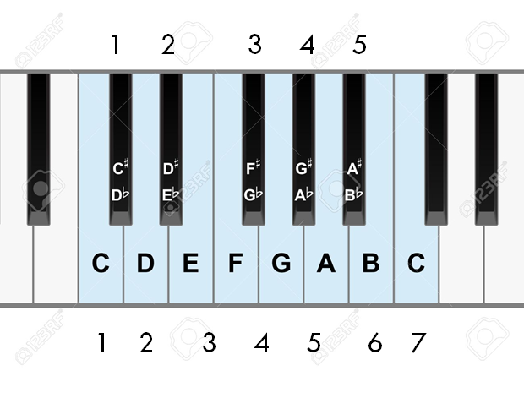
SEMITONE / HALF-STEP
TONE / STEP
Notes:
- In western music pitch are separated in to 7 main tones, can anyone tell me what these tones are? Or sing them.
- Great, now when we talk about the distance between each tone we call them intervals, but when we talk about the distance between the same low and higher tone, we call them intervals.
#sing doremi

Slide 3
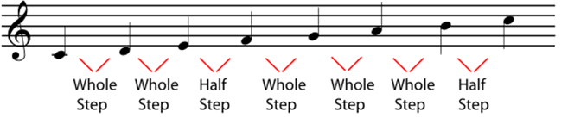

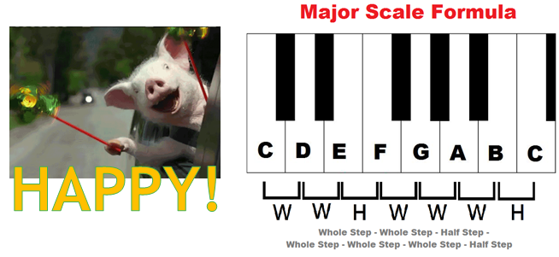
Major Scale

Slide 4
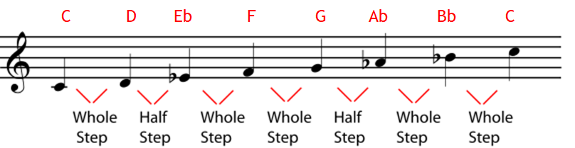
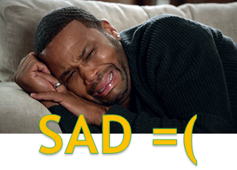
Minor Scale

Slide 5
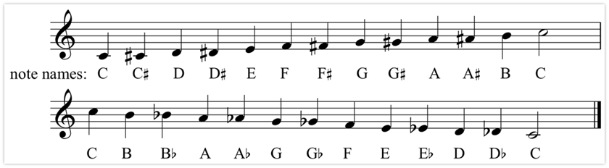
Chromatic Scales

Slide 6
Test your ears
1.
2.
3.
4.
5.
6.
7.

Slide 7


Leaps & Steps
Interval | Names
2nd | Major/ Minor 2nd
3rd | Major/ Minor 3rd
4th | Perfect 4th
5th | Perfect 5th
6th | Major/ Minor 6th
7th | Major/ Minor 7th
8th | Octave
Leap
Step

Slide 8
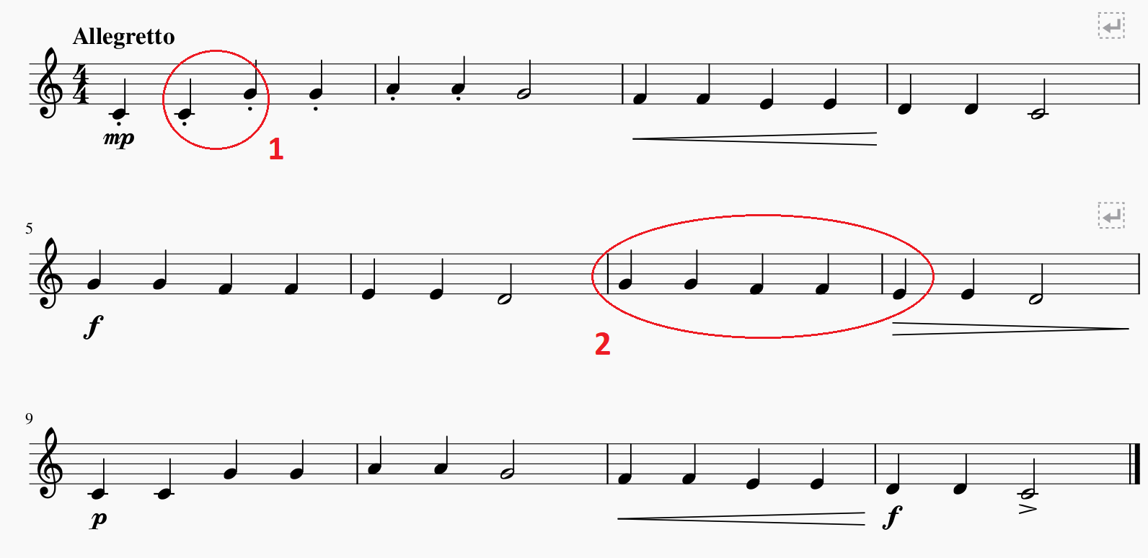
Let’s do some “analysis”!

Slide 9
Tone Color
•The quality to distinguish different tones of different instrument is called tone color, OR timbre (pronounced tam’-ber)
•Tone color is described by words such as bright, dark, brilliant, mellow, and rich.
•Listening*
•Wagner Longherin (disc1, no.1)
•Stravinsky firebird (disc1, no.8)

Slide 10

Theme
The musical material on which part or all of a work is based, usually having a recognizable melody and sometimes perceivable as a complete musical expression in itself, independent of the work to which it belongs. – grove music online
Theme can be recognizable through melody or rhythm

Slide 11
Harmony
Kenny Lim

Slide 12
Topics
Chords
Key
Musical Textures
Musical Form techniques

Slide 13
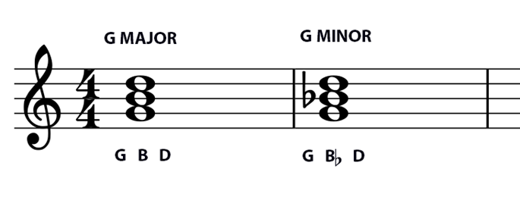
Chords: Triads
Combination of THREE or more tones sounded at once
Triads are the most basic chord, made up of alternate tones of the scale

Slide 14
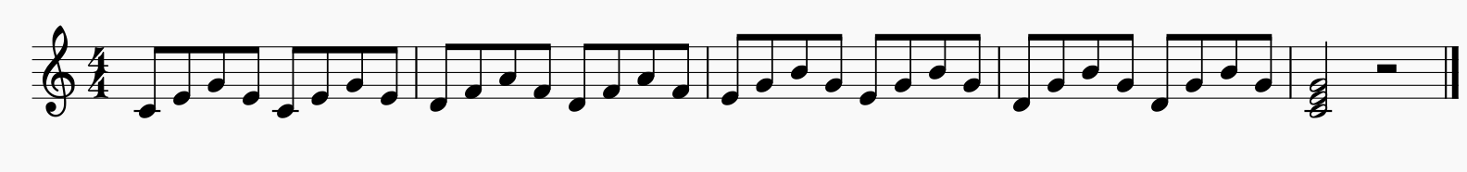
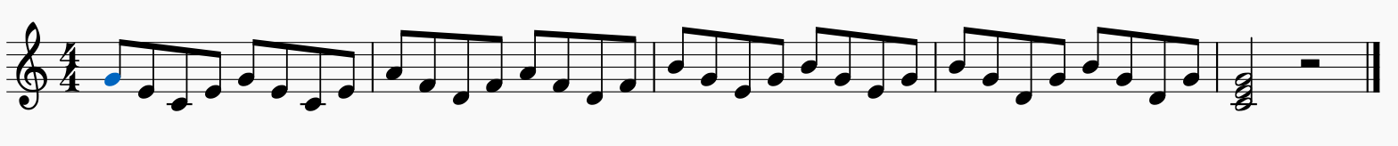
Broken Chords
Broken chords are when the individual tones of a chord are sounded one after another.

Slide 15
Consonance & Dissonance
Consonance is a tone combination that sounds stable.
Dissonance is a tone combination that sounds unstable.
Consonances are points of arrival, rest, and resolution.
A dissonance has its resolution when it moves to a consonance.
When a resolution is delayed or accomplished in unexpected ways, a drama, suspense, or surprise is created.

Slide 16
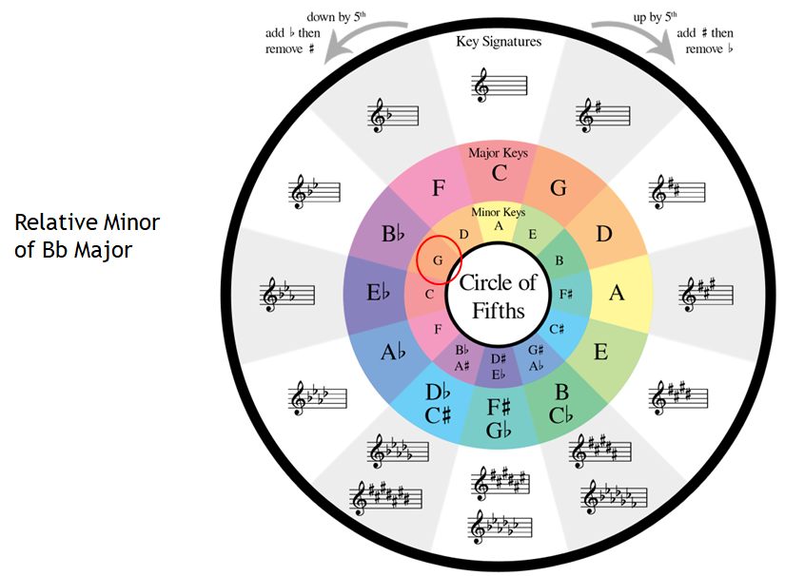
Keys: Circle of fifths

Slide 17
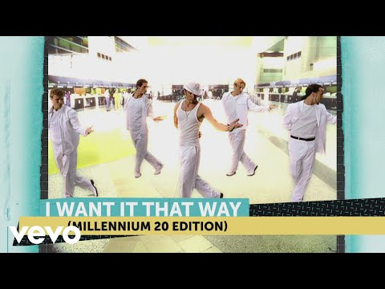
Modulation & Tonic Key
Tonic key is also known as the TONIC or HOME KEY.
MODULATION is when the TONIC KEY shifted away to another KEY.

Slide 18
Musical Texture
Monophonic Texture
Single melodic line without accompaniment.
Polyphonic Texture
Simultaneous performance of two or more melodic lines of relatively equal interest.
Homophonic Texture
One melody accompanied (by chords).

Slide 19
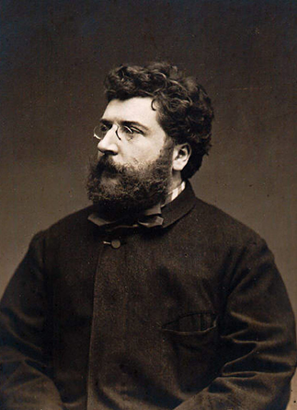
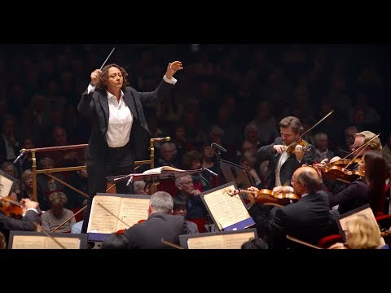
Listening
Bizet Farandole from L’Arlesienne Suite No.2

Slide 20
Basic Musical Form
Two-part (Binary) Form:
A (Statement) - B (Counterstatement)
Three-part (Ternary) Form:
A (Statement) - B (Contrast) - A (Return)
A
B
A
B
A

Slide 21
Musical Form
Techniques that create Musical Form:
Repetition - Creates a sense of unity
Contrast - Provides variety
Variation - Keeping some musical thought while changing others, gives a work unity and variety at the same time.

Slide 22


Slide 23
Topics throughout history
Middle Ages (450 - 1450) Renaissance (1450 - 1600) Baroque (1600 - 1750) Classical (1750 - 1820) Romantic (1820 - 1900) Twentieth Century to 1945 1945 onwards

Slide 24
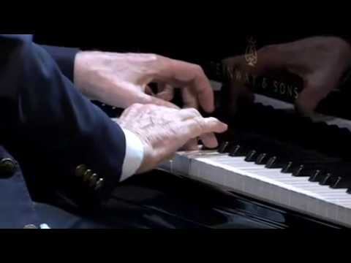

Slide 25

Have a great week ahead!

